Slide 1
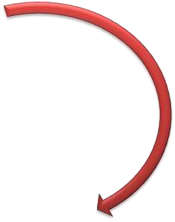
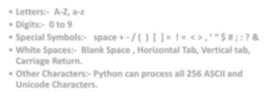
PYTHON CHARACTERSET
PYTHON CHARACTER SET
Letters:- A-Z, a-z
Digits:- 0 to 9
Special Symbols:-
space + - / ( ) [ ] = ! = < > , ‘ “ $ # ; : ? &

Slide 2
TOKENS / LEXICAL UNITS
1. Key Words
5.
Punctuators
2.
Identifiers
TOKENS
4.
Operators.
3. Literals

Slide 3
What is Keyword or reserved word?

Slide 4
1. Keyword/Reserved Word
What is Keyword?
Keywords are also called as reserved words these are having special meaning in python language. The words are defined in the python interpreter hence these cant be used as programming identifiers.

Slide 5
Some Keywords of Python Language

Slide 6
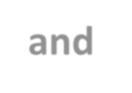
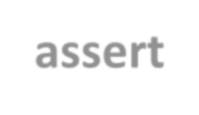
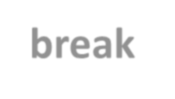
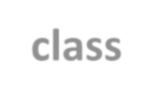
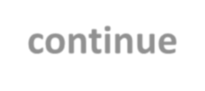
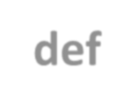
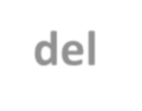
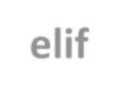
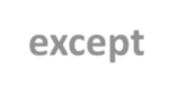
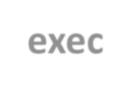
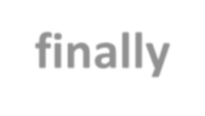
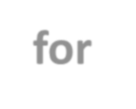
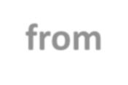
and assert
Some Keywords of Python Language
break continue del
else exec for
class def elif except finally from

Slide 7
2. IDENTIFIERS
What is an identifier?
A Python Identifier is a name given to a function, class, variable, module, or other objects that you’ll be using in your Python program.
In short, its a name appeared in the program.
For example: a, b, c
a b and c are the identifiers and a b & c and , are the tokens

Slide 8
PYTHON NAMING CONVENTIONS
SOME VALID IDENTIFIERS:
Myfile1 y3m9d3
MYFILE
DATE9_7_8
_xs
_FXd
SOME INVALID IDENTIFIERS:
MY-REC | 28dre | break
elif | false | del

Slide 9
3. LITERALS / CONSTANT VALUES
What is literals?
Literals are also called as constants or constant values these are the values which never change during the execution of program.

Slide 10
What are the types of literals?

Slide 11
TYPES OF LITERALS / CONSTANT VALUES
What are the types of literals?
String Literals or Constants.
Numeric Literals or Constants.
Boolean Literals or Constants.
Special Literal None.
Literal Collections.

Slide 12
2. NUMERICAL LITERALS
Numerical Literals have the following types:
int or integers float
Complex
Whole numbers
real values
Complex numbers

Slide 13
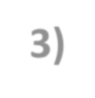
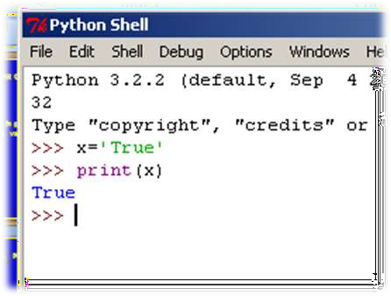
3) BOOLEAN LITERALS OR CONSTANTS.
A Boolean literal in python is used to represent the Boolean values (true or false).

Slide 14
PUNCTUATORS
Punctuators are also called as separators
The Followings are used as punctuators:
Brackets | [ | ]
Parentheses | ( | )
Braces | { | }
Comma | ,
Semicolon | ;
Colon | :
Asterisk | *
Ellipsis | …
Equal Sign Pound Sign #
=

Slide 15
COMMENTS
Comments are non executable statements in a program.
Single line comment always starts with #
Multiline comment will be in triple quotes. For example “’ write a program to find the simple interest “’.
Note: Triple apostrophe is called docstrings.

Slide 16
STATEMENTS
In computer terminology statement refers to an instruction.Program contains several statements. A collection of statements makes program
Another name for a program is code.

Slide 17
FUNCTIONS
What is function?
Function is a self contained program segment which carries out some specific well defined task.
For Example:
def sqr( num ):
result= num *num
print ("Square = " , result) sqr()

Slide 18
VARIABLES AND ASSIGNMENTS
Named labels are called variables. For example: marks =86
78 | 79 | 80 | 81 | 82 | 83 | 84 | 85 | 86 | 87
2000 | 2016 | 2018 | 2026 | 2032 | 2044 | 2048 | 2050 | 2054 | 2068
marks refers to location 2054

Slide 19
INPUT ( ) FUNCTION
For Example:
p = input(“Enter the value”)
x = int(input(“Enter x value”))
reads the value and converts it in to intege type data or value.
y=float(input(“Enter y value”))
reads the value and converts it in to float type data or value.

Slide 20
